Slide 1
PmuRide: A Ride-sharing App for PMU students
GEIT_3351: Software Engineering I
Section 101
Fall 2023/2024
Dr. Ilyes Jenhani
Computer Scientist: Mohammed Alqadda, 202002837
Computer Engineer: Ibrahim Aldossary, 201800259

Slide 2
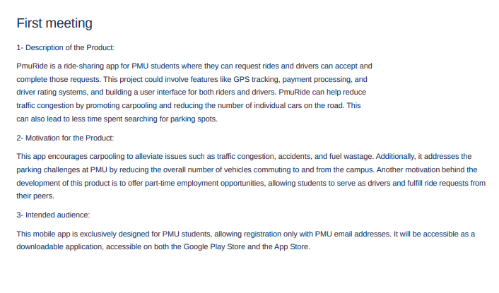
Introduction

Slide 3

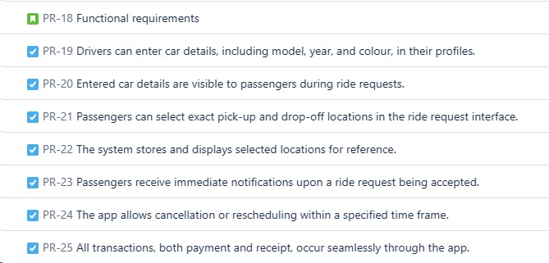
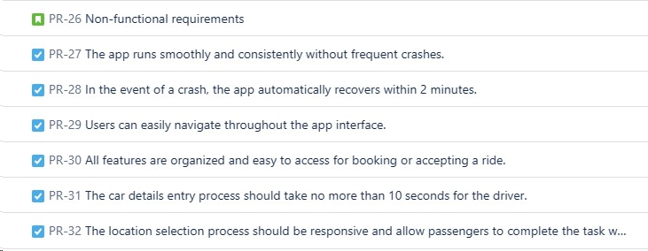
Requirements
Functional Requirements
Non Functional Requirements

Slide 4
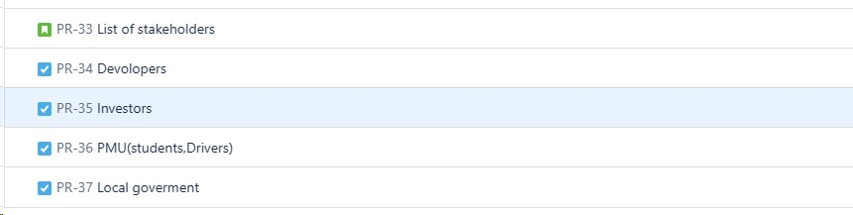
Stakeholders

Slide 5

SCRUM

Slide 6
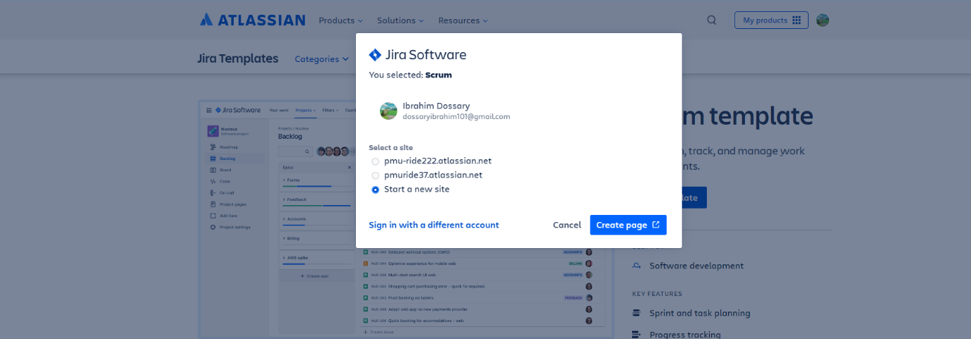
Project Initiation and team formation:

Slide 7
Team formation:
Mohammed Alqadda (Development team member)
Ibrahim Aldossary (Scrum master)
PMU (Product owner)

Slide 8
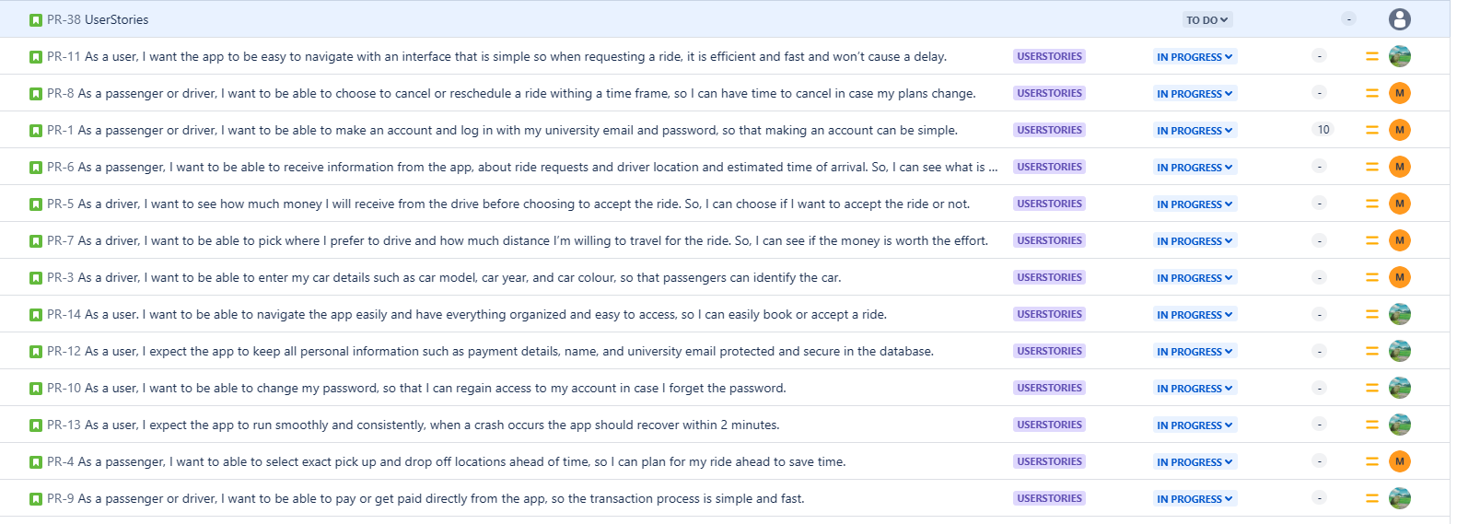
Backlog Creation

Slide 9
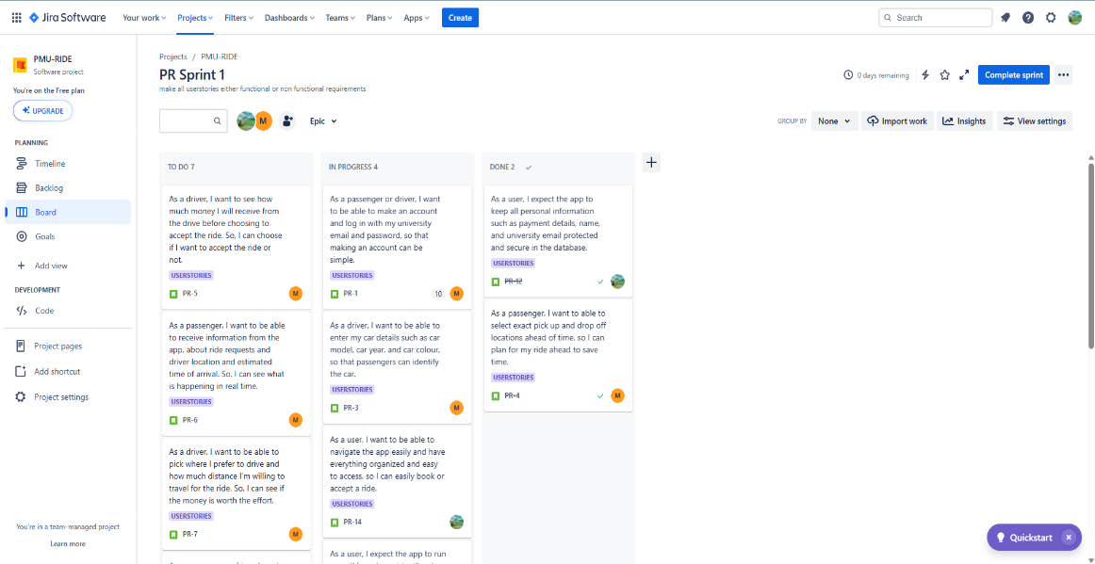
Sprint Execution

Slide 10
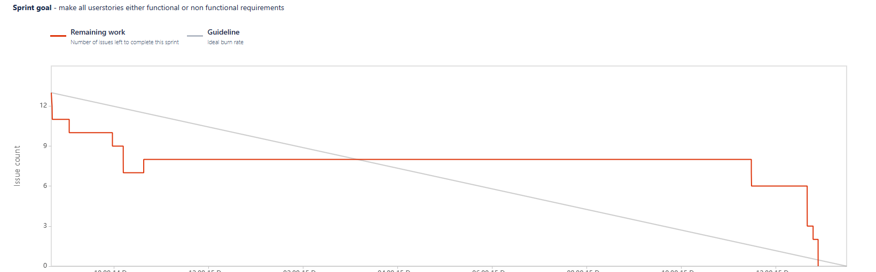
Start the 2nd sprint Project closure

Slide 11
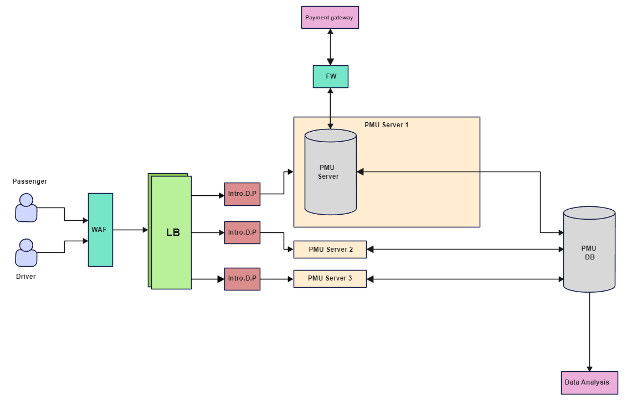
System architcure

Slide 12
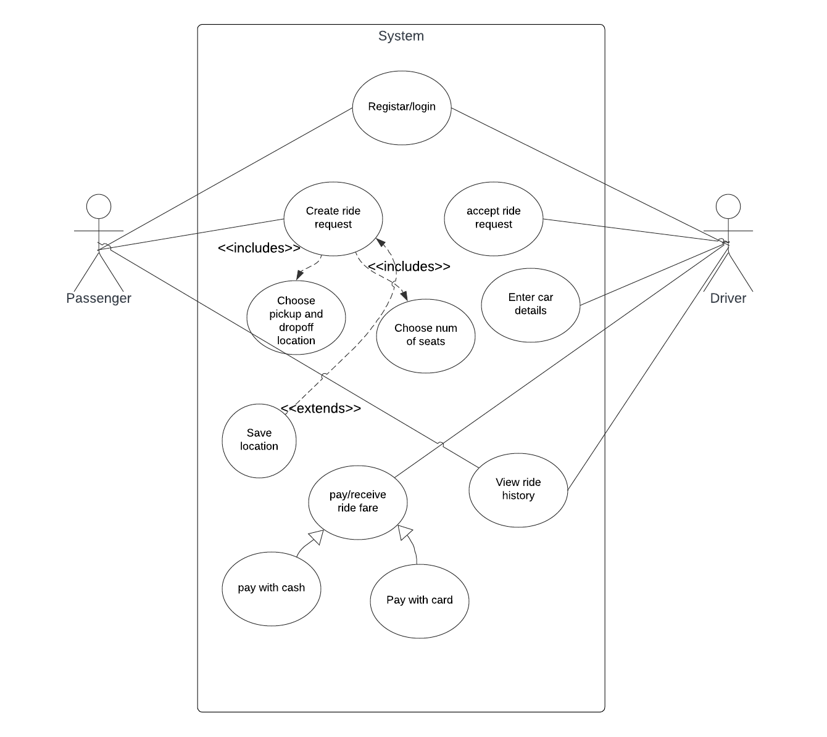
Use case diagram

Slide 13
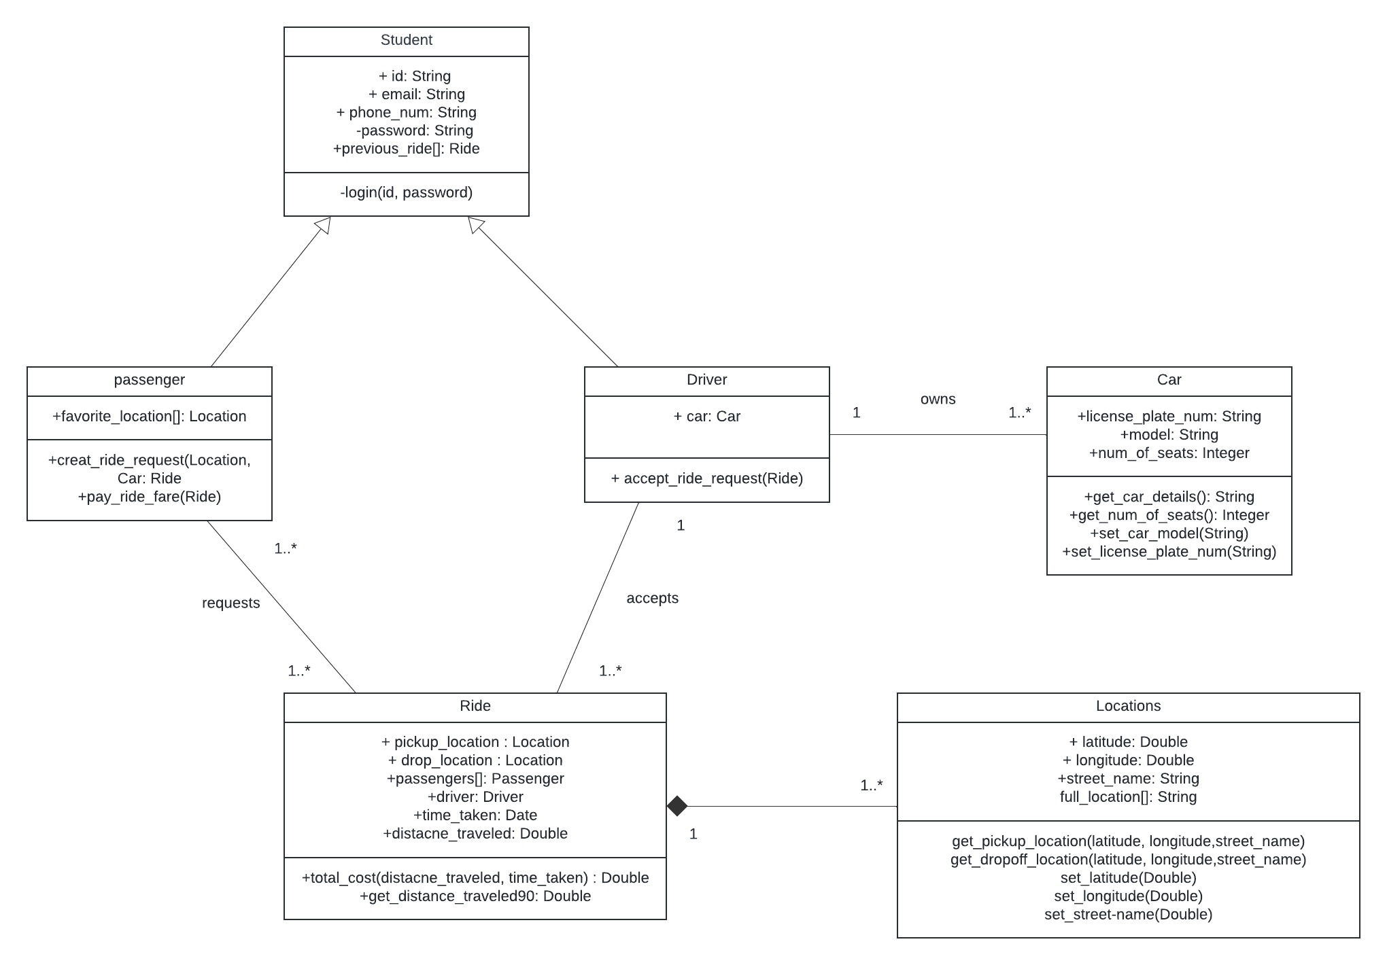
Class diagram

Slide 14
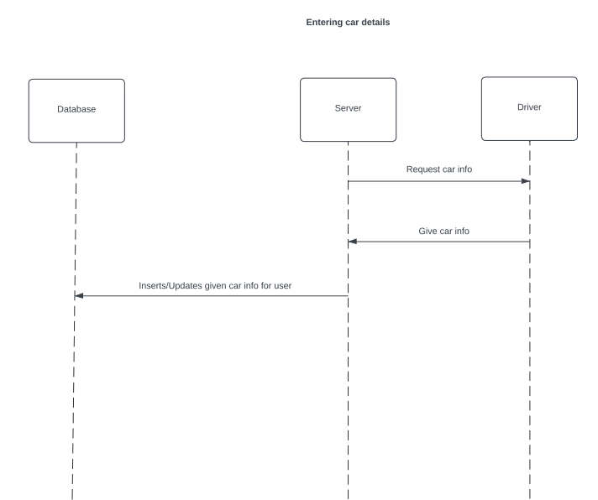
Sequence diagrams

Slide 15
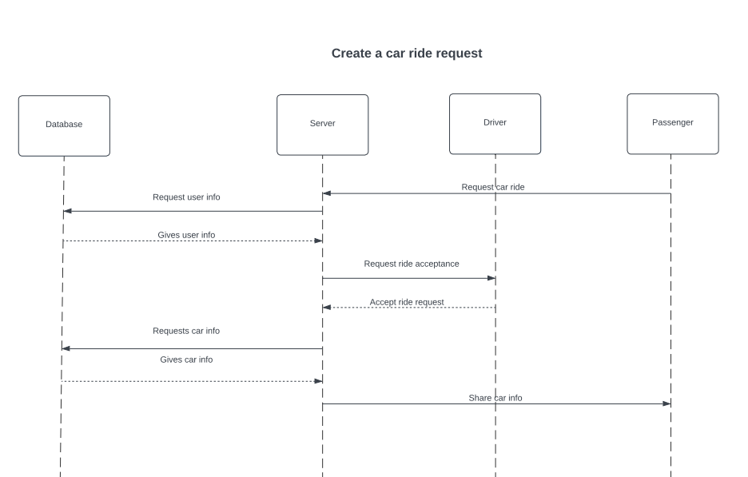
Sequence diagrams

Slide 16
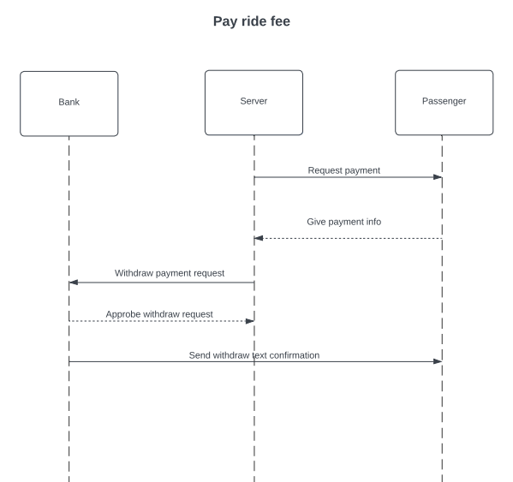
Sequence diagrams

Slide 17
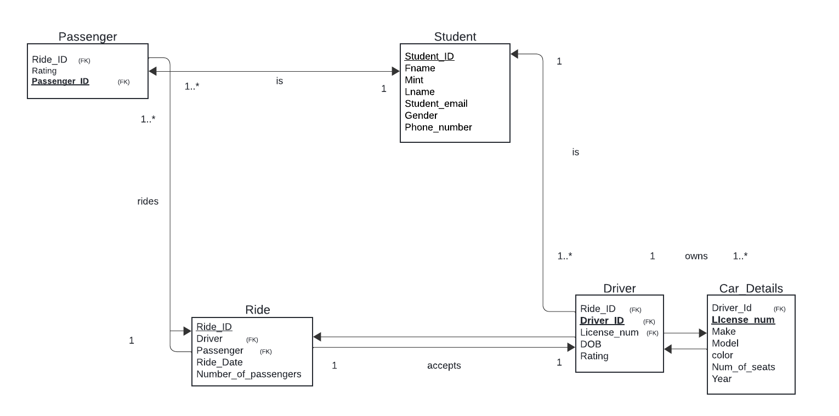
DB diagram

Slide 18
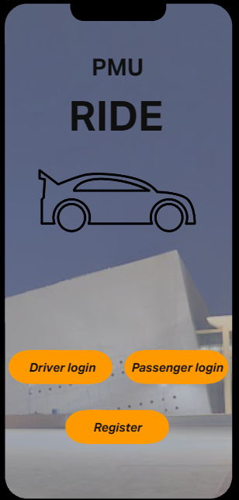
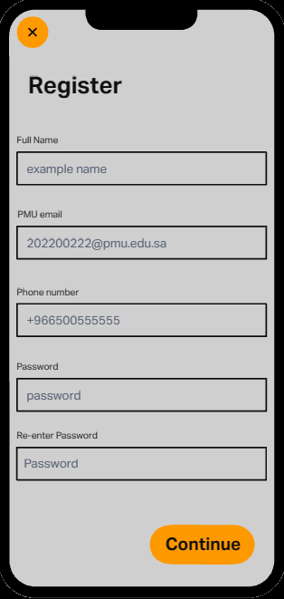
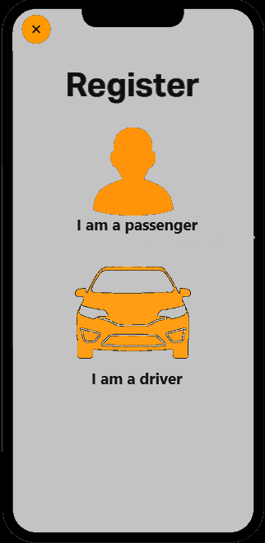
UI mockups

Slide 19
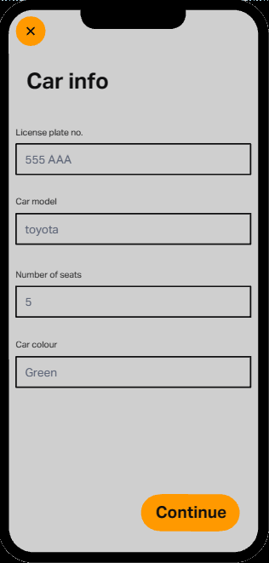
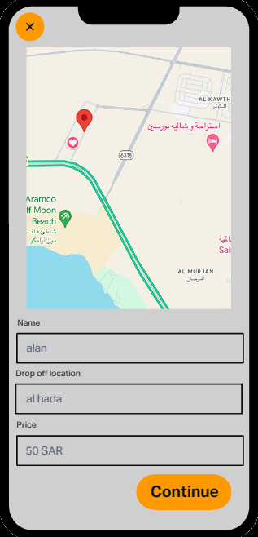
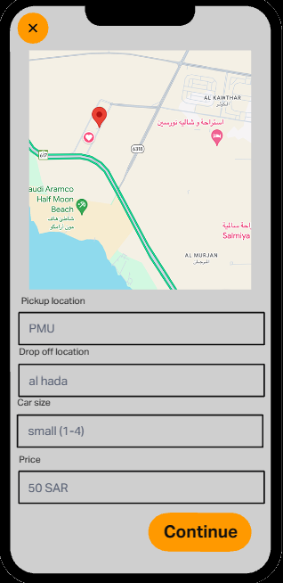
UI mockups

Slide 20
Coding and Implementation
This was done using GitHub as repository.
Our public GitHub repository: https://github.com/MFQ7/PMURide.git
MFQ7: Mohammed Alqadda
barhoom-22: Ibrahim Aldossary

Slide 21
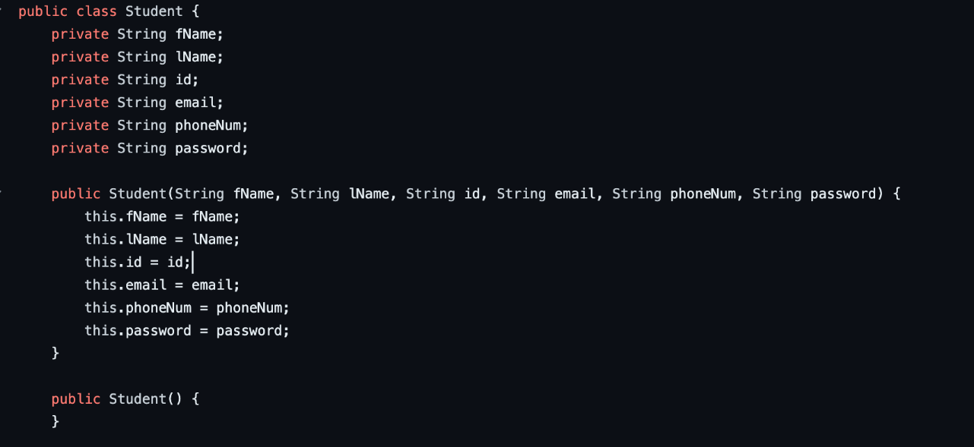
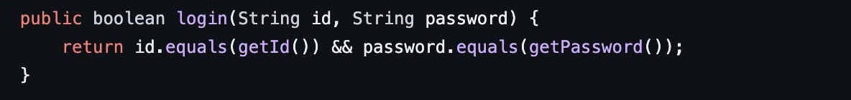
User Account Creation and Log in

Slide 22
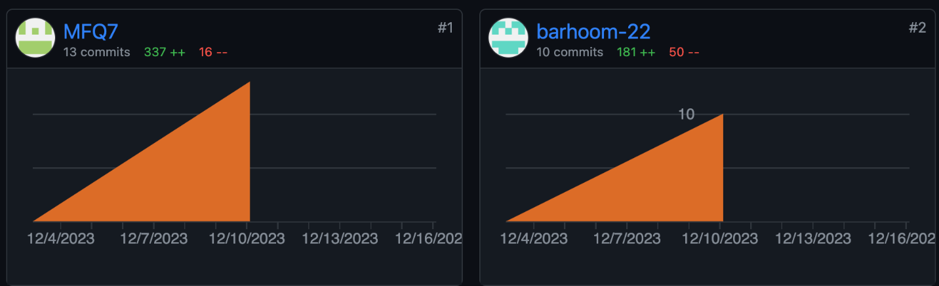
Commits and Pushes by Different Team Members:

Slide 23
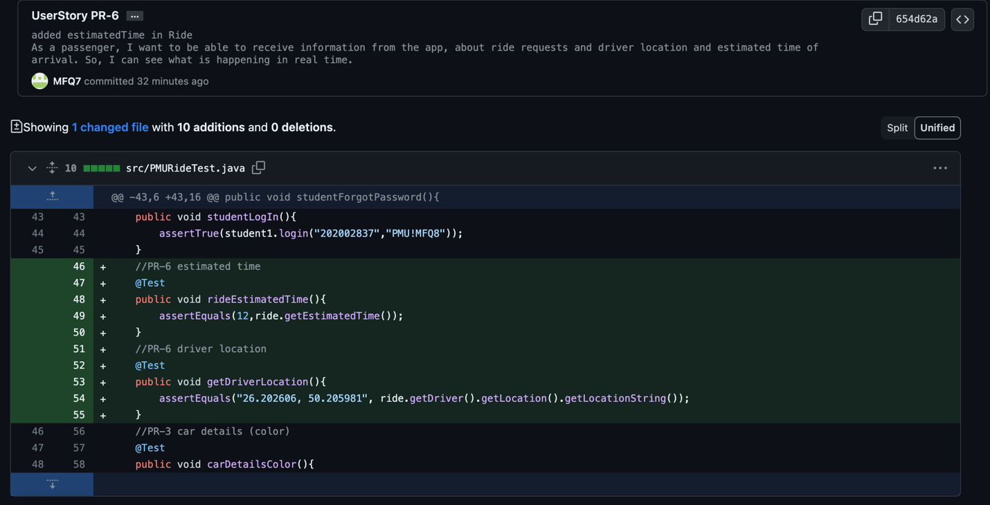
Example of Changes by Mohammed

Slide 24
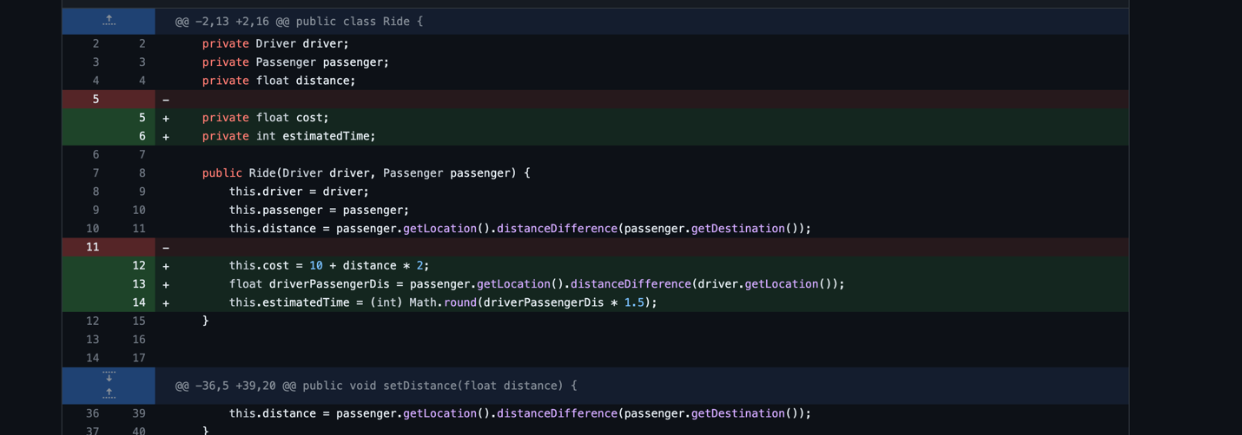
Example of changes by Ibrahim:

Slide 25
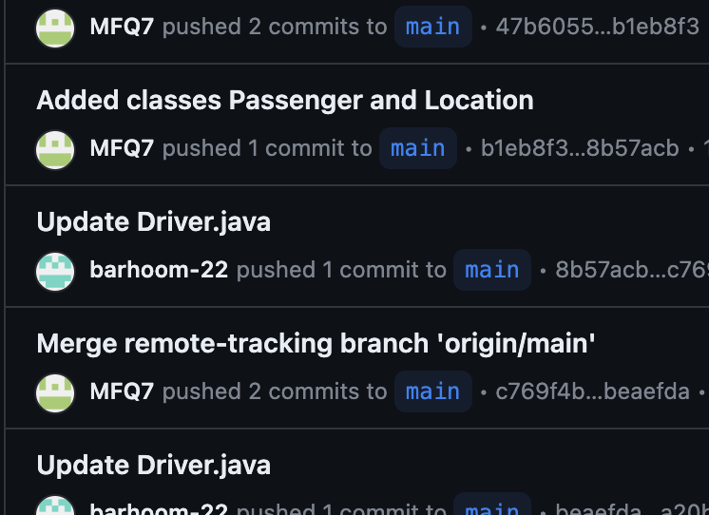
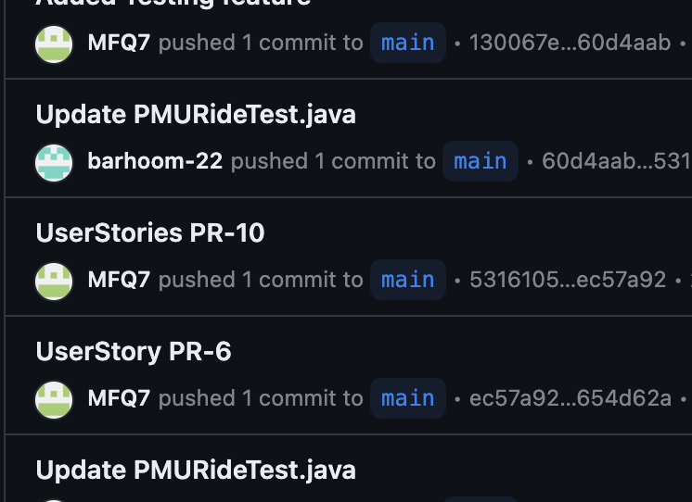
Using Git as a Version Control Tool:

Slide 26
Testing
Our public GitHub repository: https://github.com/MFQ7/PMURide.git
Using Junit Testing
We used ATDD (Acceptance Test Driven Development) and BDD (Behavior-DrivenDevelopment) to formulate our test cases.

Slide 27
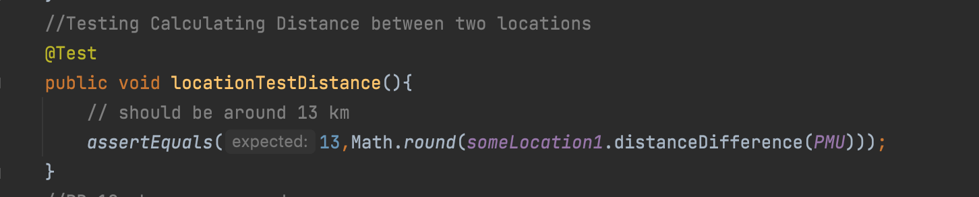
We have one BDD (Behavior-Driven Development)
The locationTestDistance() method is a test case designed to verify the accuracy of distance calculation between two geographical locations.

Slide 28
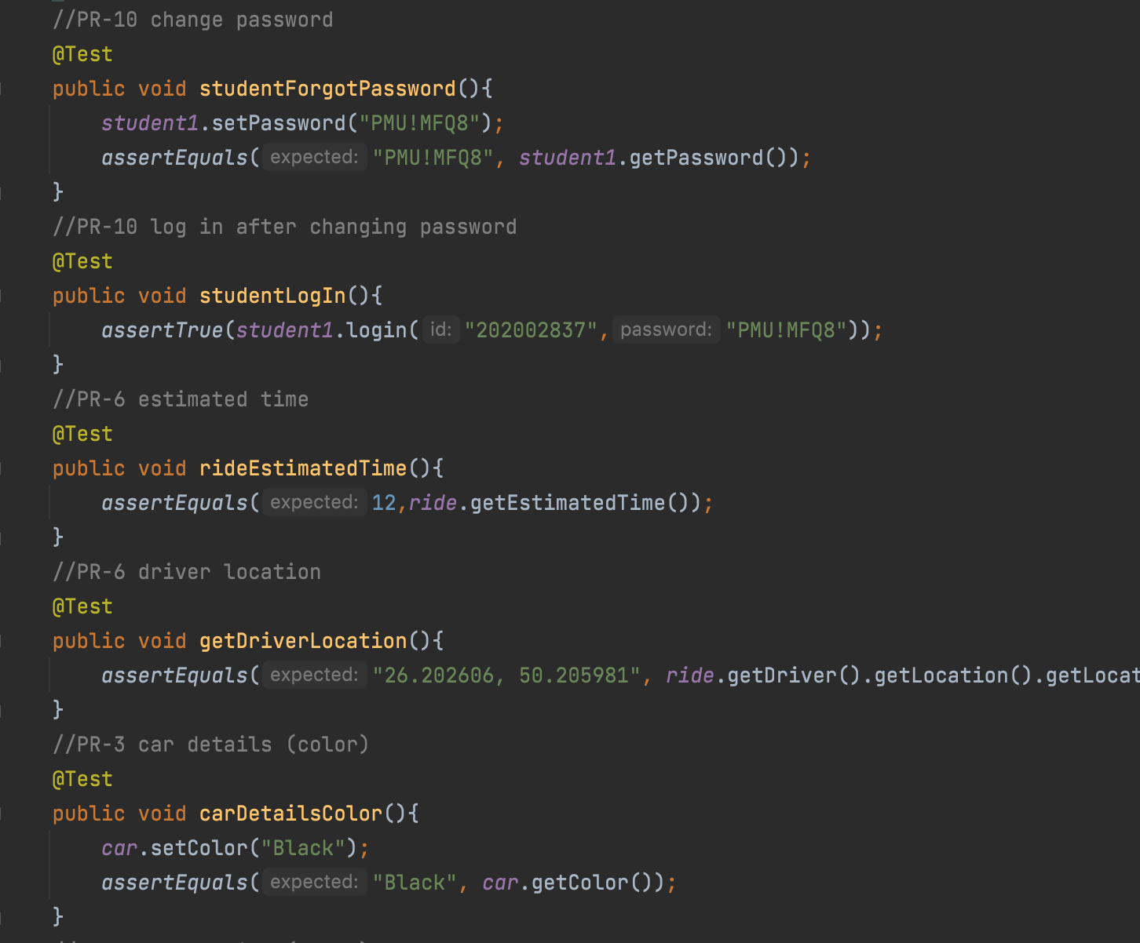
The rest are ATDD (Acceptance Test Driven Development)
These test cases were taken from User Stories.

Slide 29

Thank you!

